Slide 1

Coal mine safety monitoring and alert system

Slide 2
Presented By:
Faria Sultana Ananya
Dept: CSE
Jahangirnagar University
50th Batc
Umme Anom Nupur
Dept: CSE
Jahangirnagar University
50th Batc
Name: Mredul Kumar Kabiraj
Jahangirnagar University
Dept: Environmental sciences Batch: 47

Slide 3
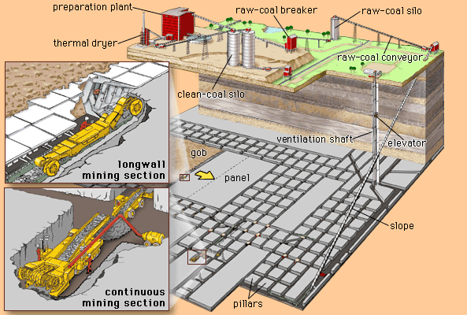
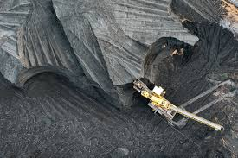
summary
The project is an IoT-based system that monitors underground coal mine conditions using sensors to measure gas levels, temperature, humidity, and airflow. It automatically triggers alerts when hazardous conditions are detected, ensuring rapid response to improve worker safety and prevent accidents.

Slide 4
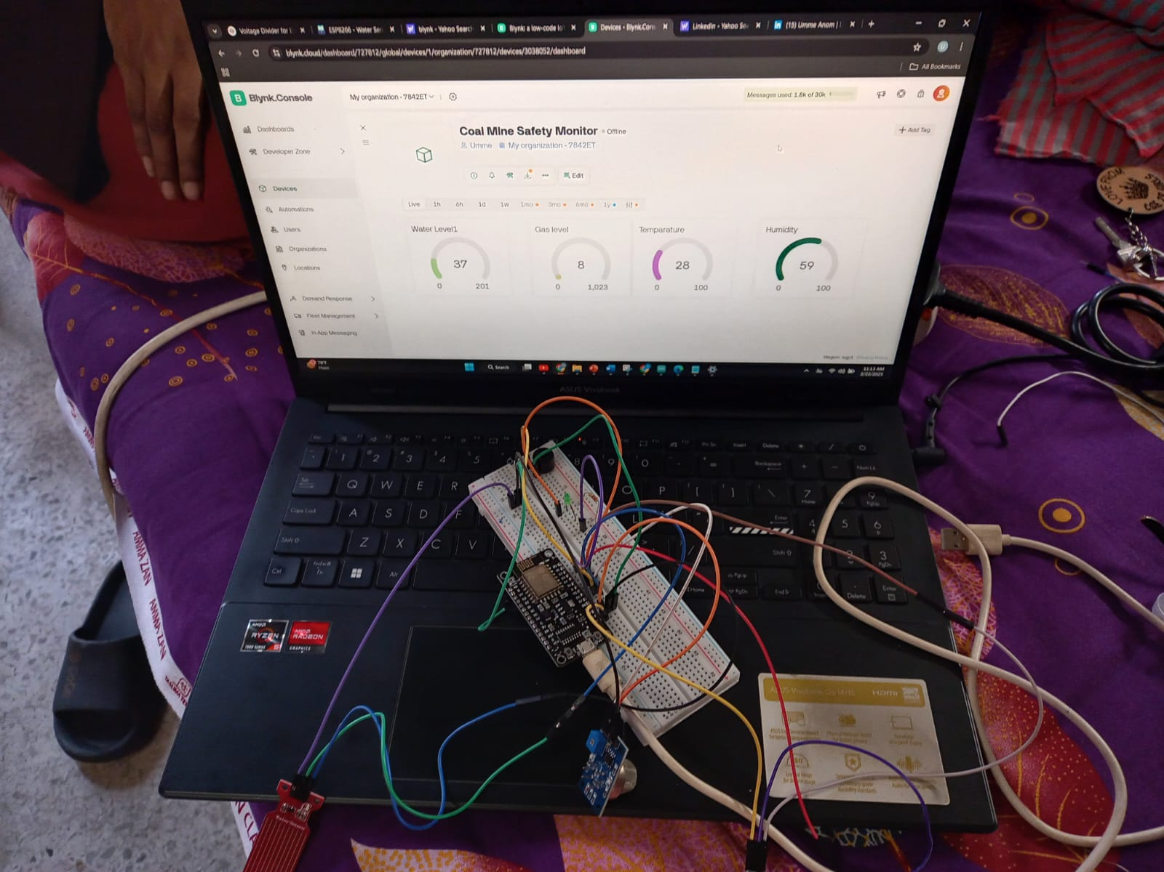
Circuit Diagram

Slide 5
APPLICATION
1. Real-Time Environmental Monitoring:
Automated Alerting:
Data Logging and Analytics
Remote Monitoring
Integration with Safety Systems

Slide 6
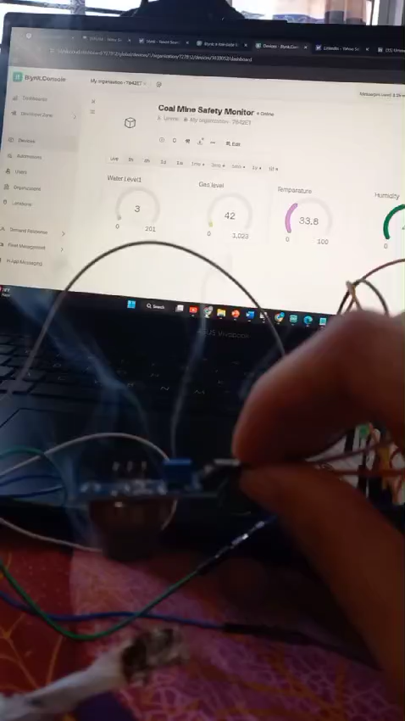
Gas Level, Temperatura :

Slide 7
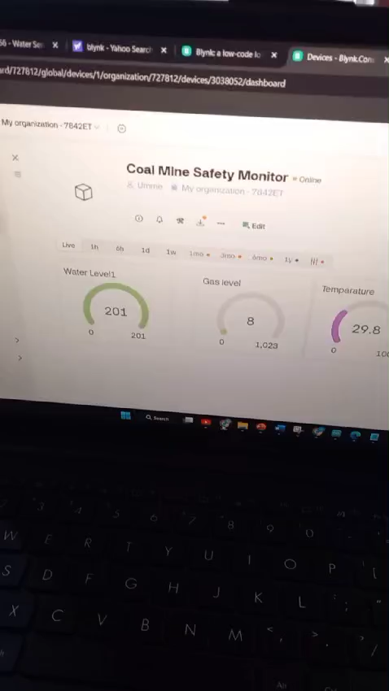
Water Level:

Slide 8
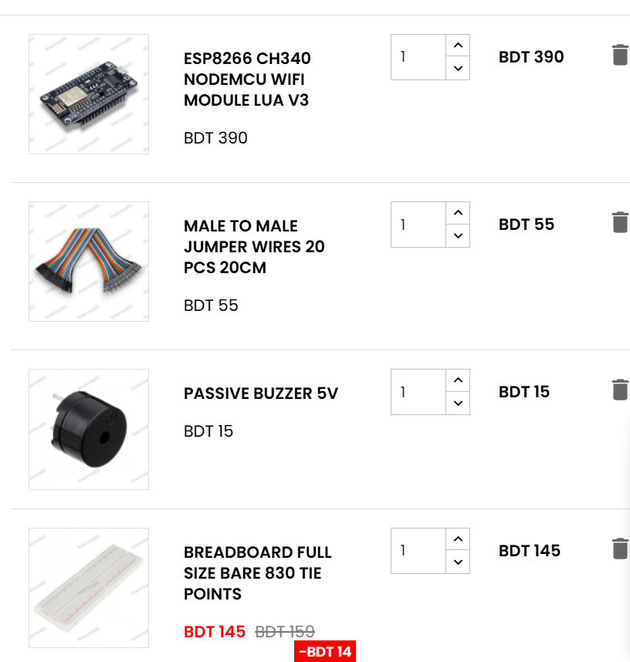
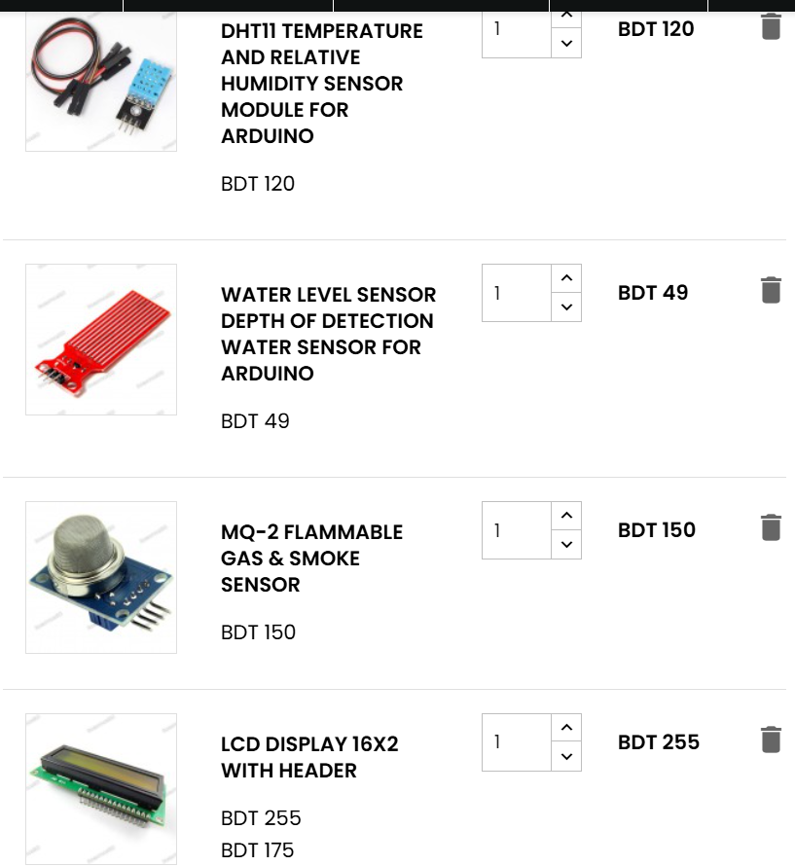
Cost:
ESP8266 390tk
Connection wire 55tk
Buzzer 15tk
Dht11 sensor 120tk
Water sensor 49tk
MQ 2 sensor 150
Lcd display 255tk
Total Cost 1300tk

Slide 9



contact
01715661666
01722-256692
0 1718-319119
https://www.linkedin.com/in/faria-sultana-ananya-8493b1349/
https://www.linkedin.com/in/umme-anom-462539309/
www.linkedin.com/in/
parvinsultanaac@gmail.com
ummeanom@gmail.com
mredulkabiraj420@gmail.com

